Slide 1
Computer Science
Programming – Algorithms (Flowcharts)

Slide 2
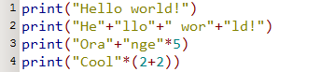
Starter: Python Basics
Use Python to work out what these will print to screen.
Write code to display your name five times with one print statement.
Write code to display ‘BANANA’ by typing ‘AN’ only once.
Key Words: Algorithm, Flowchart, Pseudocode

Slide 3
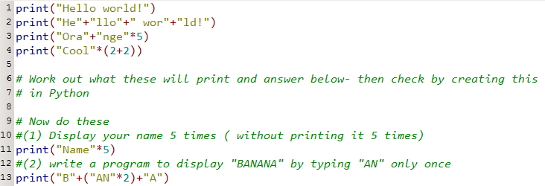
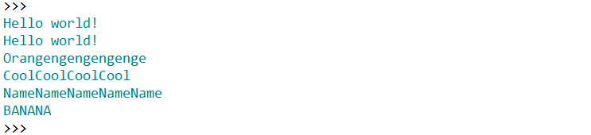
Starter 1: Solution
Key Words: Algorithm, Flowchart, Pseudocode

Slide 4
Learning Objectives
Programming Lesson
Today we are: Understanding the different types of algorithms and shapes that can be used in Flowcharts. Creating flowcharts/pseudocode based on problems and programs already made.
Key Words: Algorithm, Flowchart, Pseudocode

Slide 5
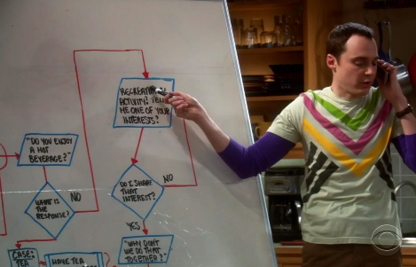
What is an Algorithm?
A process or set of rules to be followed, especially useful when problem solving.
Two types:
Flowchart
Pseudocode
Key Words: Algorithm, Flowchart, Pseudocode

Slide 6
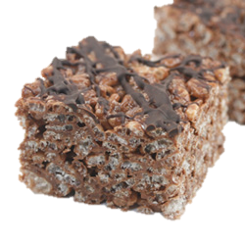
Creating Algorithms – Rice Krispie Cakes
What you’ll need (Variables) 60g unsalted butter 3 table spoons golden syrup 1 x 100g bar milk or dark chocolate 90g Rice Krispies
How to make them (Instructions)
Melt the chocolate
Add the butter, and stir in until melted
Add the syrup, stir
Add the Rice Krispies and gently stir in to the chocolate mix
Spoon in to a mould
Leave to cool
Key Words: Algorithm, Flowchart, Pseudocode
Notes:
Ask students to think about how they might make the chocolate squares
Focus on the recipe being a sequence of one instruction after another – Complete in pairs.

Slide 7
Identifying flowchart symbols
Terminator – Used to start or stop a program.
Input/Output – Used when you get input from the user or output from the computer.
Decision – A choice will be given. Usually Yes or No but can also display menu choices.
Subroutine- Allows you to call other subroutines. (Other flowcharts could be integrated easily.
Process – Performs a process such as adding two numbers.
Connector –Allows connection from page to page for extensive diagrams.
Key Words: Algorithm, Flowchart, Pseudocode

Slide 8
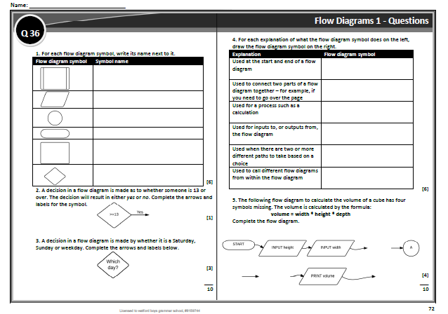
Task 1 – Flowcharts Recap
8 mins
Complete the questions related to algorithms. (You do not need to complete the first activity if you have the shapes in your book.)
You can complete this task in pairs.
Found on Page 72 (in the book) 81 (on the pdf). Complete tasks in your book.
Key Words: Algorithm, Flowchart, Pseudocode

Slide 9
Task 2 –
Creating Flowcharts
Two choices:
Create a flowchart for a program previously made. (Reverse engineering – less recommended.
Create a flowchart for one of the OCR programming problem tasks on Moodle. (Choose a short one.)
15 mins
Key Words: Algorithm, Flowchart, Pseudocode

